Slide 1
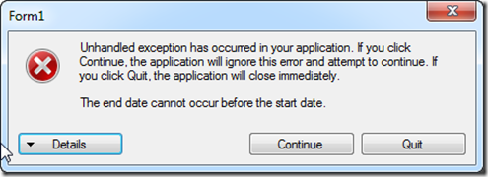
2.1 Exception Handling
academy.zariba.com

Slide 2
Lecture Content
What are Exceptions?
Handling Exceptions
The System.Exception Class
Exceptions Hierarchy
Throwing Exceptions
Best Practices

Slide 3
1. What are Exceptions
The exceptions in .NET are classic implementation of the OOP exception model
They deliver a powerful mechanism for centralized handling of errors and unusual events
Substitute procedure-oriented approach, in which each function returns an error code
Simplify code construction and maintenance
Allow the problematic situations to b processed at multiple levels

Slide 4
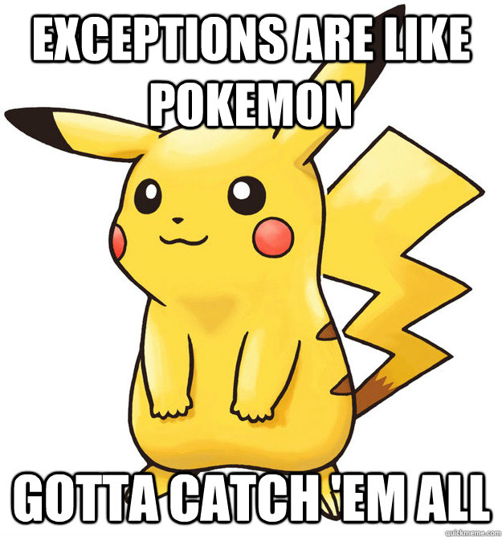

2. Handling Exceptions
Try-Catch blocks
Try-Catch-Finally blocks

Slide 5
3. The System.Exception Class
Exceptions in .NET are objects (as is everything)
The System.Exception class is base for all exceptions in CLR (Common Language Runtime)
Contains information for the error/unusual situation.
Message – text description of the exception
StackTrace – description of the stack at the moment of throwing the exception
InnerException – exception caused the current exception

Slide 6
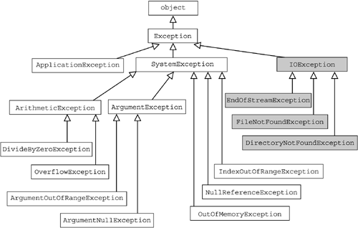
4. Exceptions Hierarchy

Slide 7
5. Throwing Exceptions
Exceptions are thrown by the “throw” keyword
When an exception is thrown the program execution stops, the exception travels over the stack to find a catch block. If the exception is not handled, an error message is displayed.

Slide 8
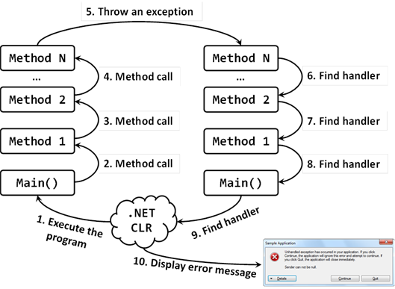
5. Throwing Exceptions

Slide 9
6. Best Practices
Choose a proper ExceptionType
ArgumentException
ArgumentNullException
ArgumentOutOfRangeException
NotSupportedException
NotImplementedException
If there is no suitable standard exception make, create your own exception class (we will learn later how to do that).

Slide 10
6. Best Practices
catch blocks should be ordered by the exception hierarchy starting with the lowest and move on to the more general exceptions.
Each catch block should handle only the exceptions which it expects
Handling all exceptions disregarding their type is a popular bad practice

Slide 11
6. Best Practices
When throwing an exception always pass a good explanation message
Bad examples – “Unexpected error”, “Invalid Argument”, “Something broke”.
Good Examples – “Bunny legs should be more than 4”, “Password should be more than 10 symbols”…

Slide 12
6. Best Practices
Exceptions decrease the performance
Throw exceptions only in situations which should be handled
Do not throw exceptions in the normal program control flow (e.g. invalid user input)
CLR could throw exceptions at any time

Slide 13
Homework
COMPULSORY – implement the 2048 game!

Slide 14

References

Slide 15



Zariba Academy
Questions

